Slide 1
Right Angle Piece Attachment

Slide 2
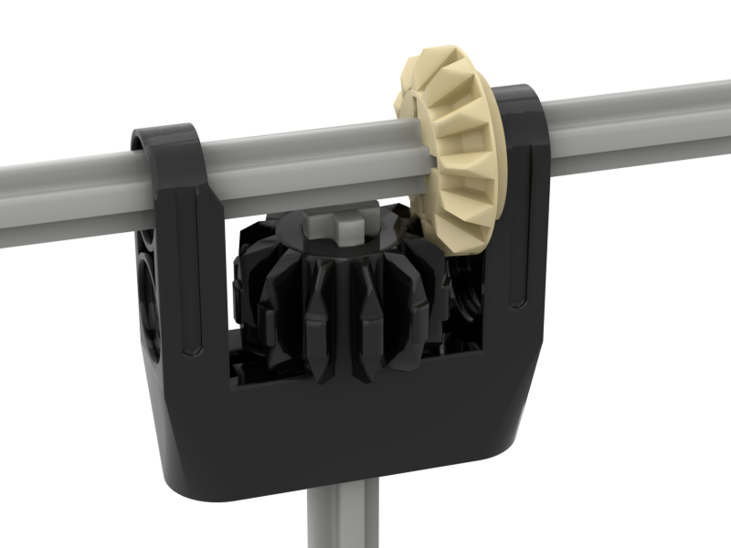
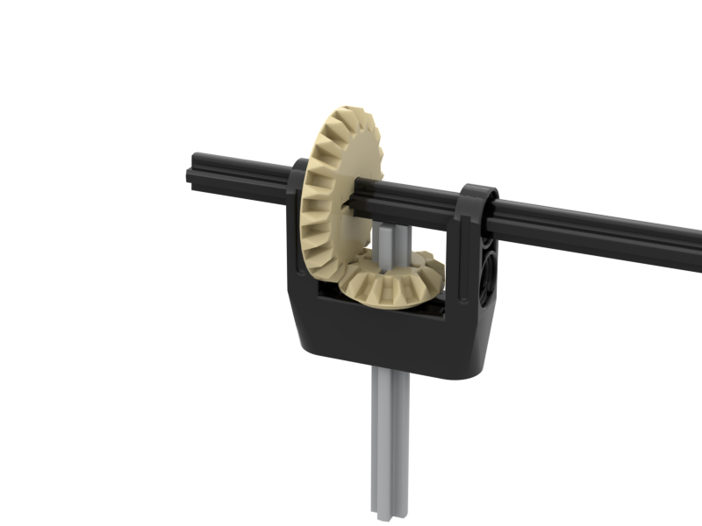
Intro
If you choose to not use the “2-L’s and 2-H’s” right angles, you can use the “Right Angle Pieces” instead. When using the Right Angle Pieces, you will only have two options for gear ratios. The advantage though is that they are easier to assemble (but not that much easier).
1:1
12:20

Slide 3
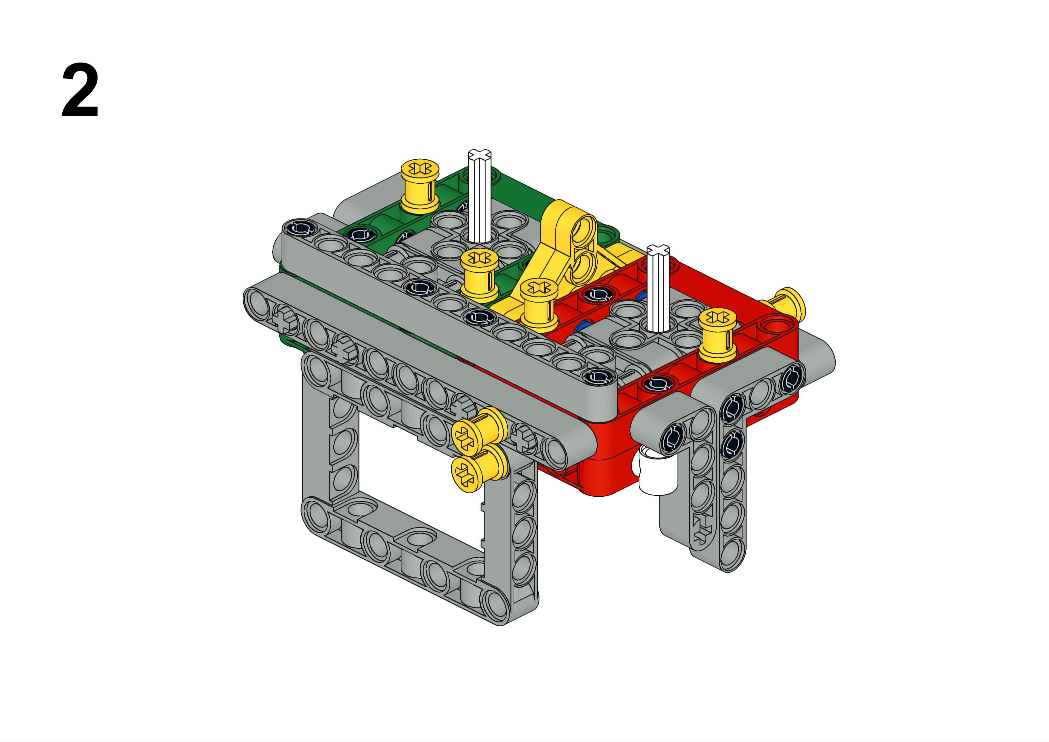
We are going to start on the red side first. Here, we are going to have an axle that points out the side (in this case, the left side, but you can easily flip the instructions for the right side). If you don’t need any axles point out the side, then skip ahead to step 11 (the slide with the green border).

Slide 4
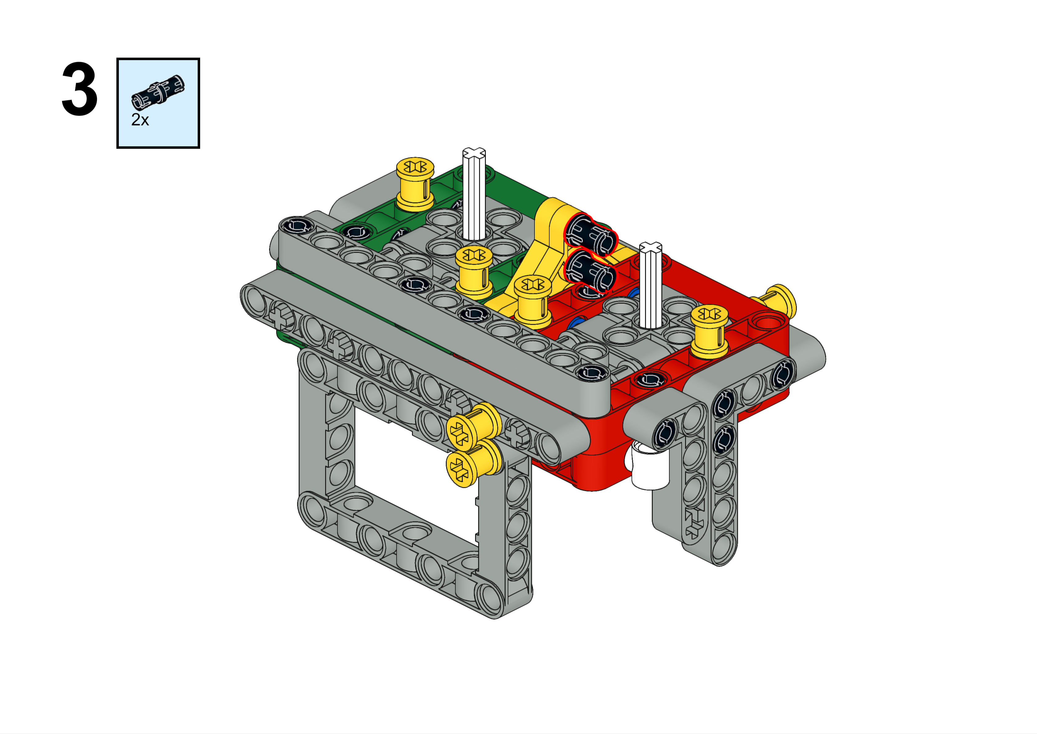
If you are going to have an axle pointing out on each side, then use the 3L long blue pegs here instead of the black pegs.

Slide 5
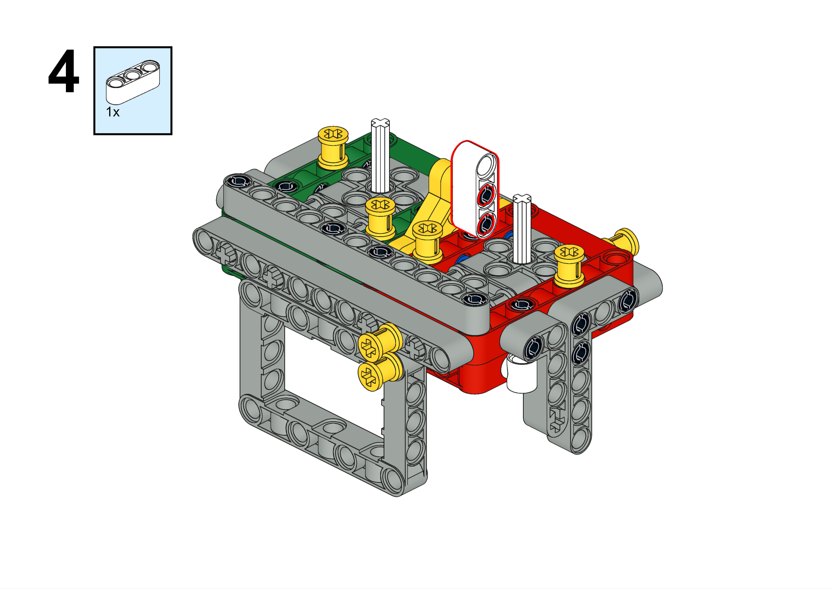

Slide 6
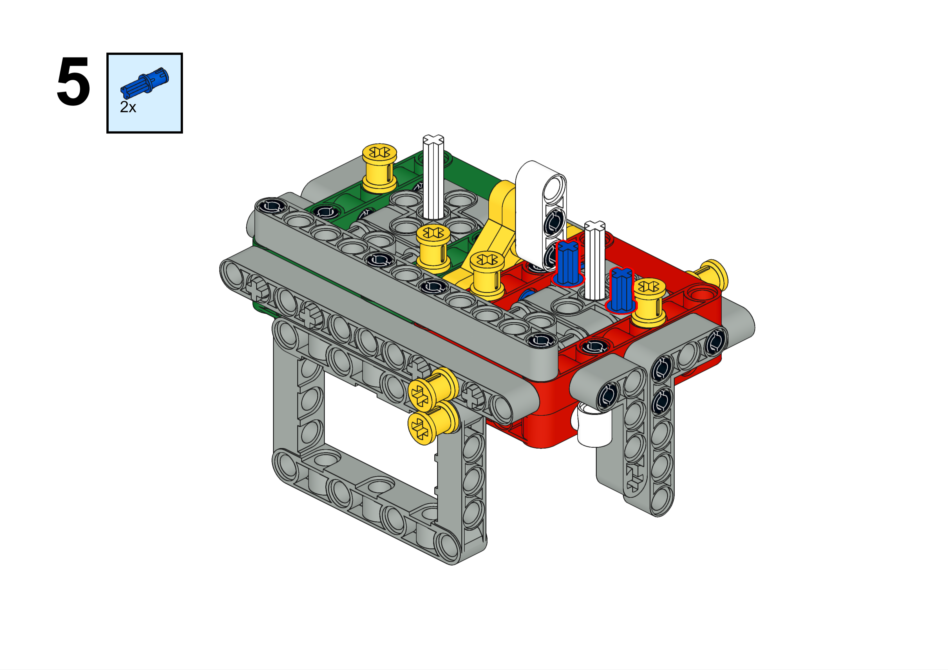

Slide 7
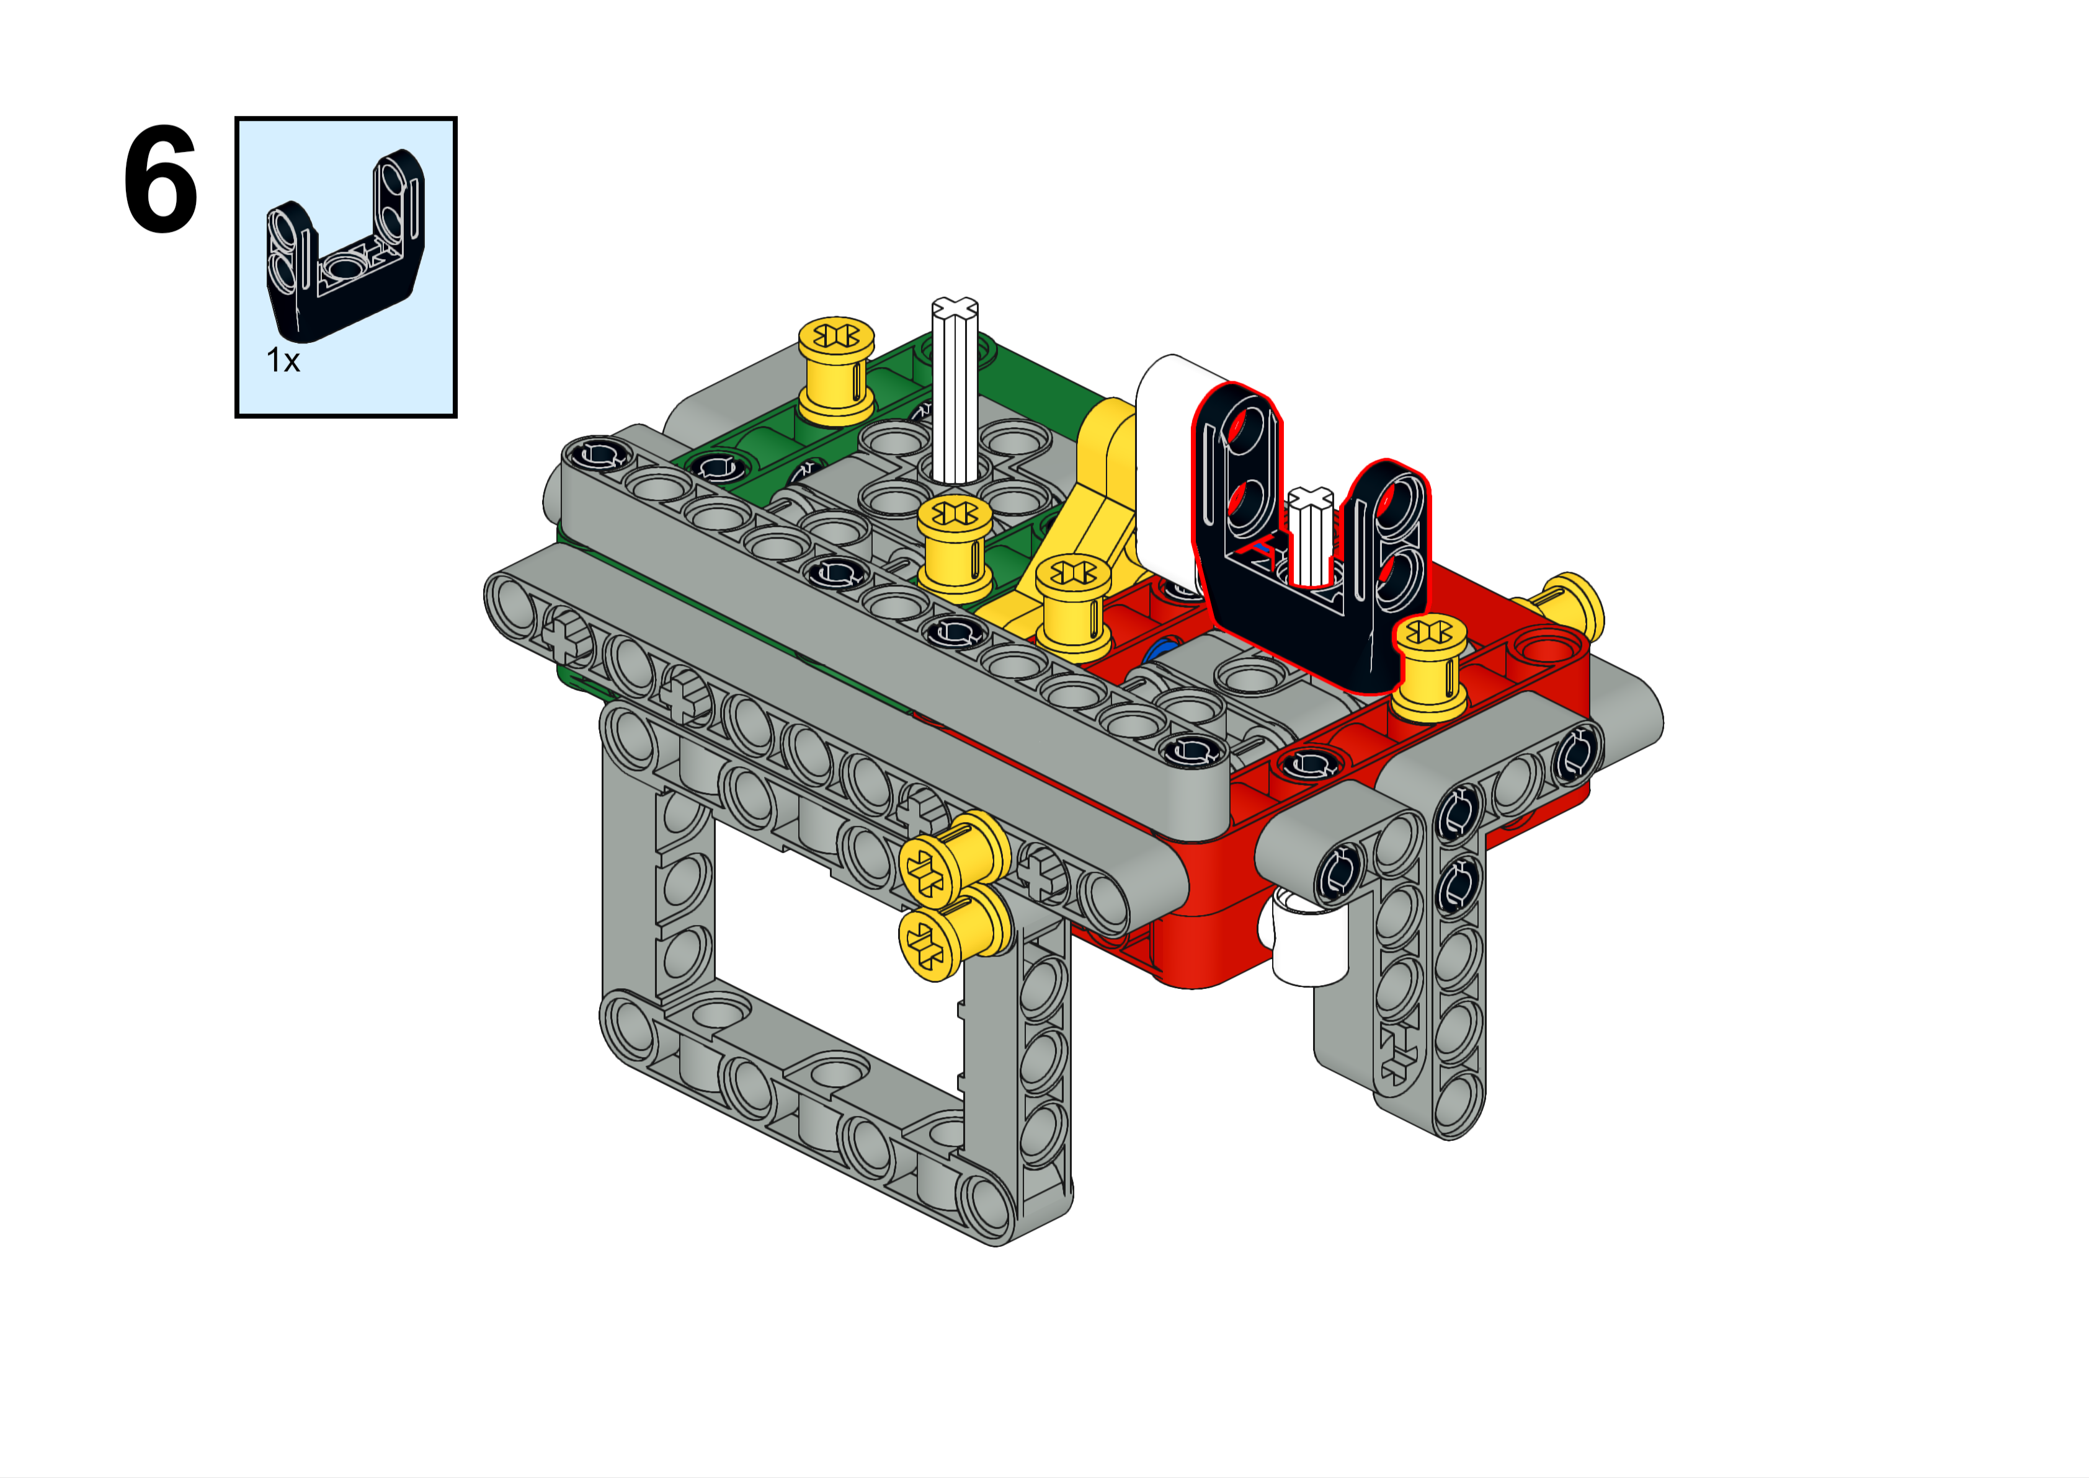

Slide 8
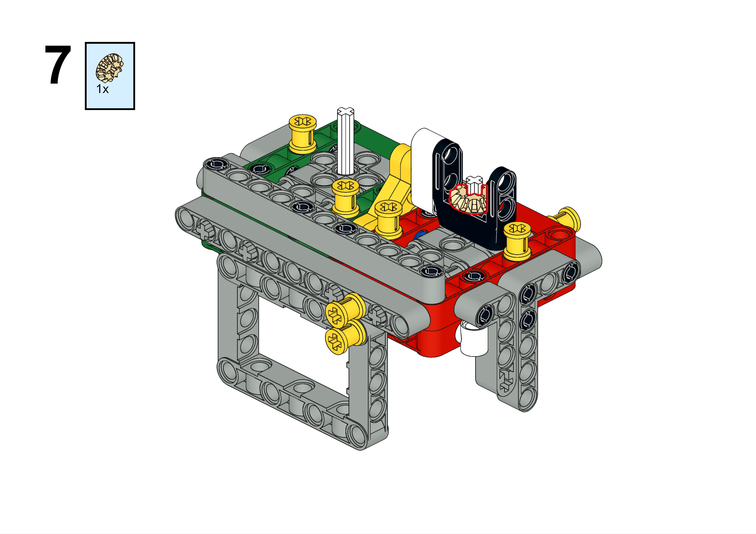
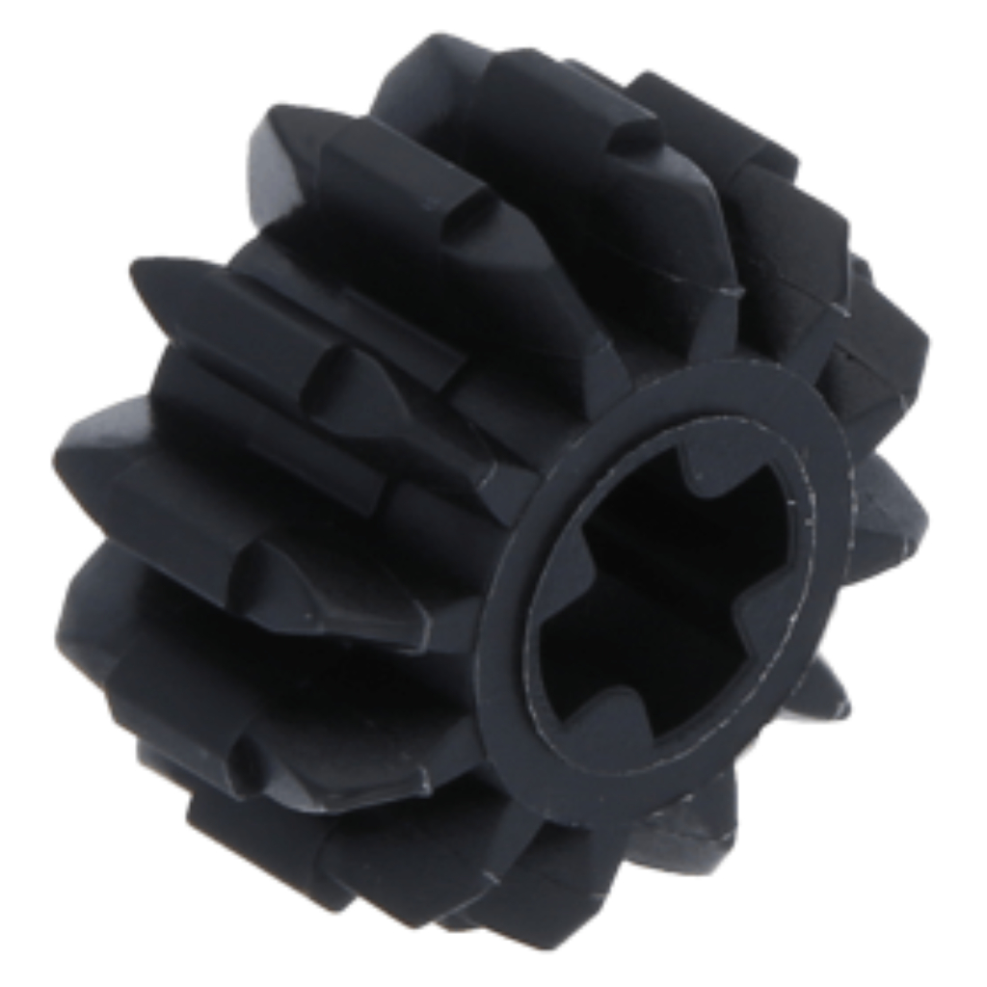
If you need 1:1 gearing, then use this gear on the next step, and on this step use this small gear. See slide 2 for an example.

Slide 9
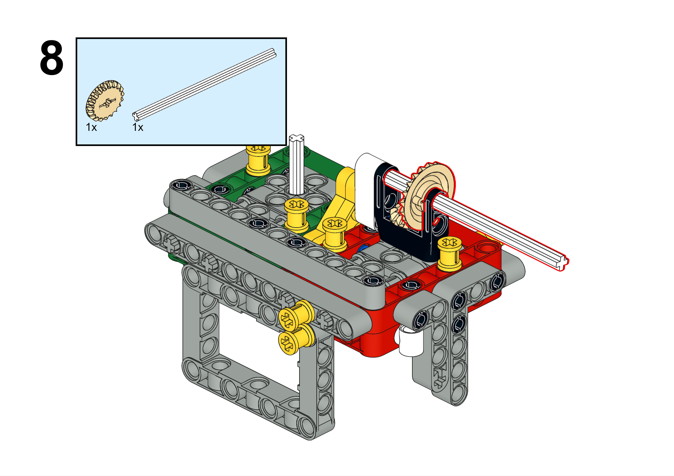

Slide 10
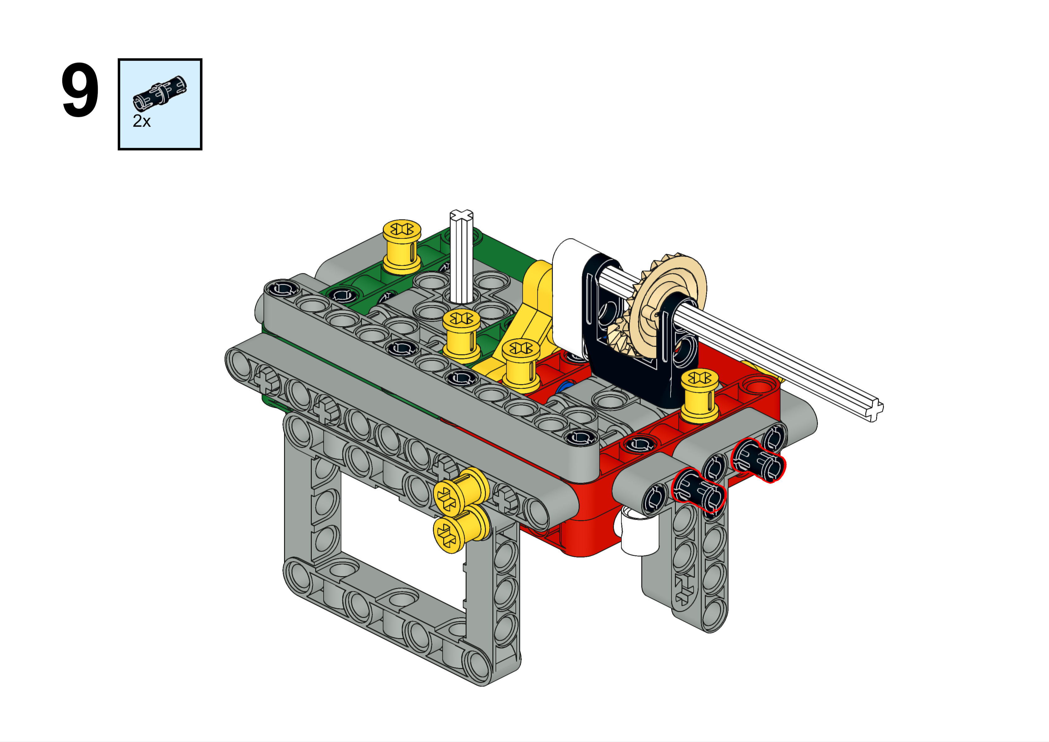

Slide 11
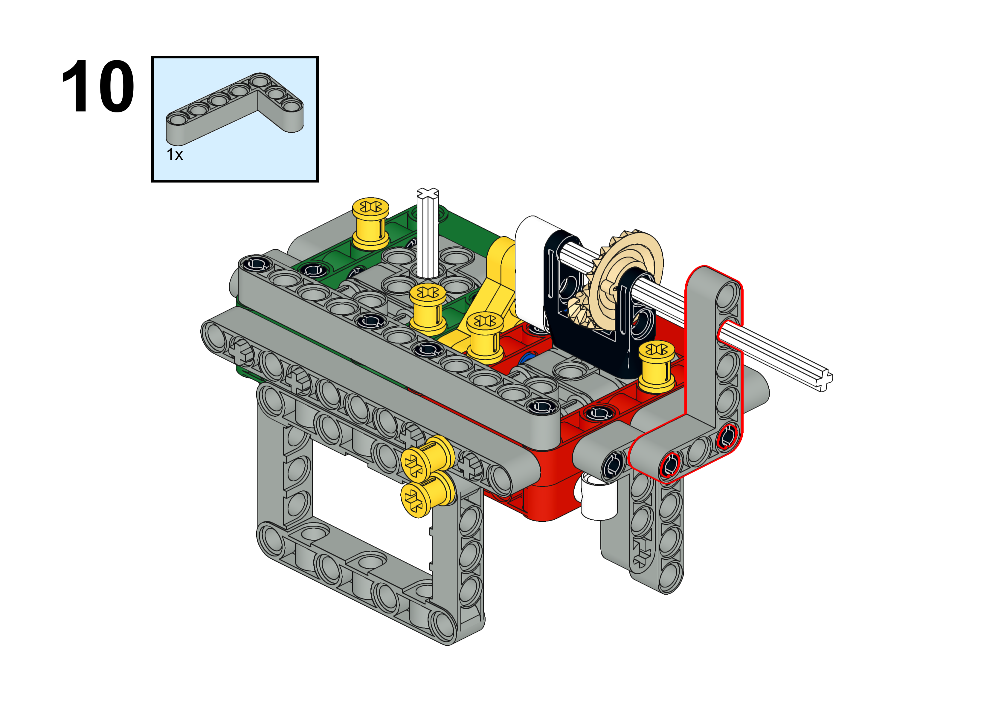

Slide 12
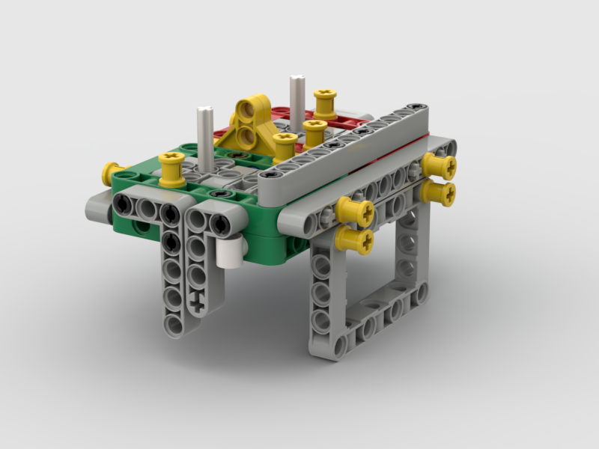
Remove this pushpin
11
Here, we are going to have an axle that points out the front. If you need axles on both sides pointing out the front, then just flip these instructions for the other side.

Slide 13
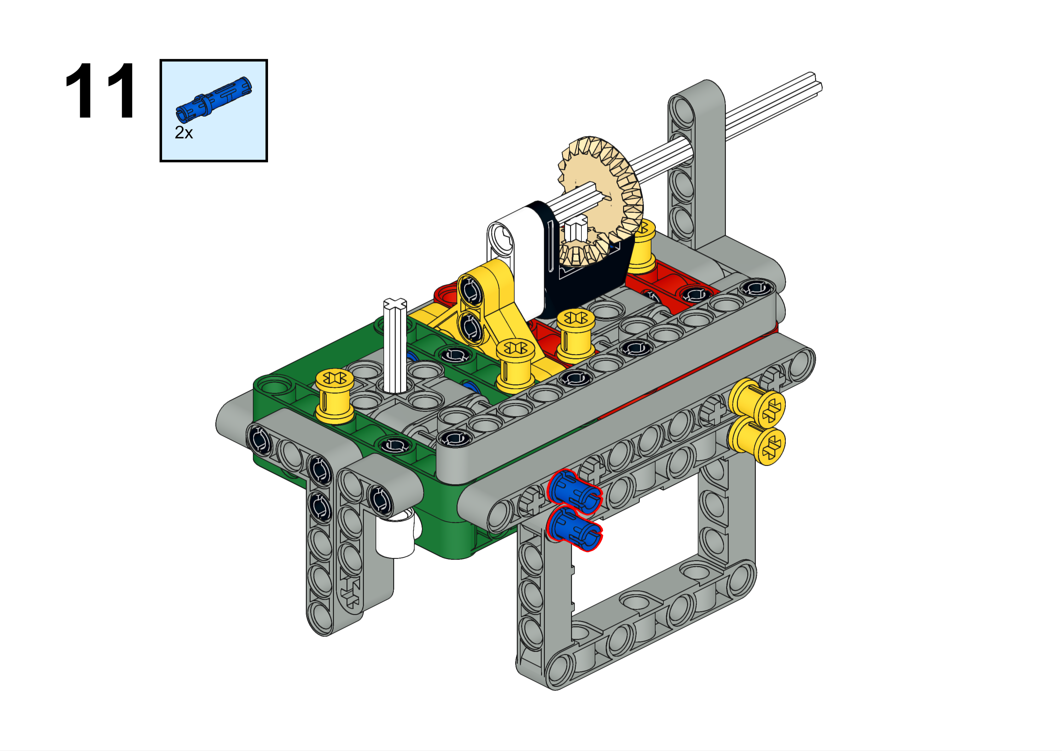

Slide 14
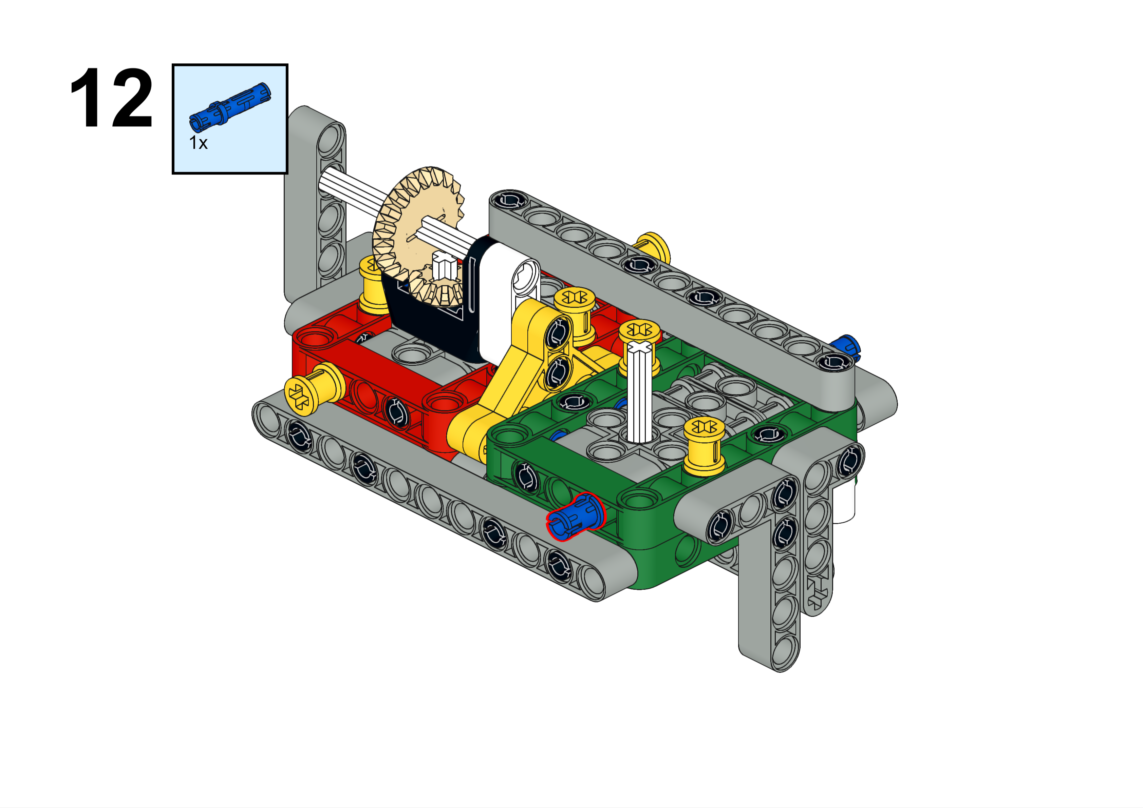

Slide 15
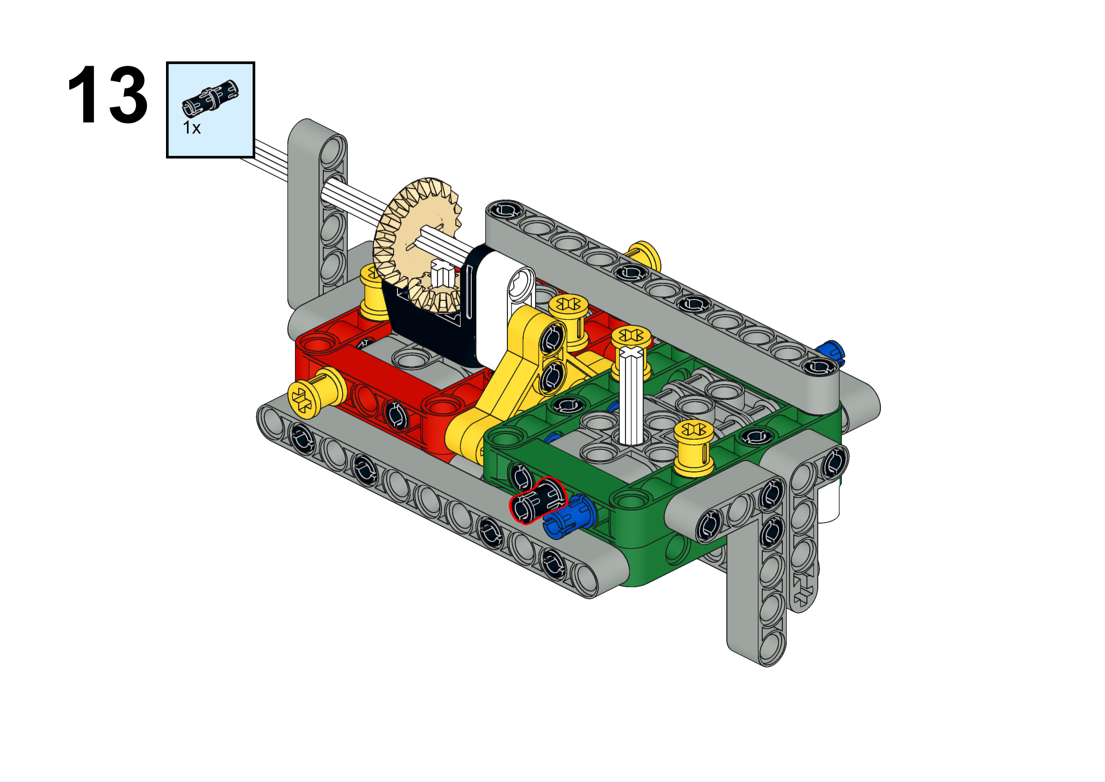

Slide 16
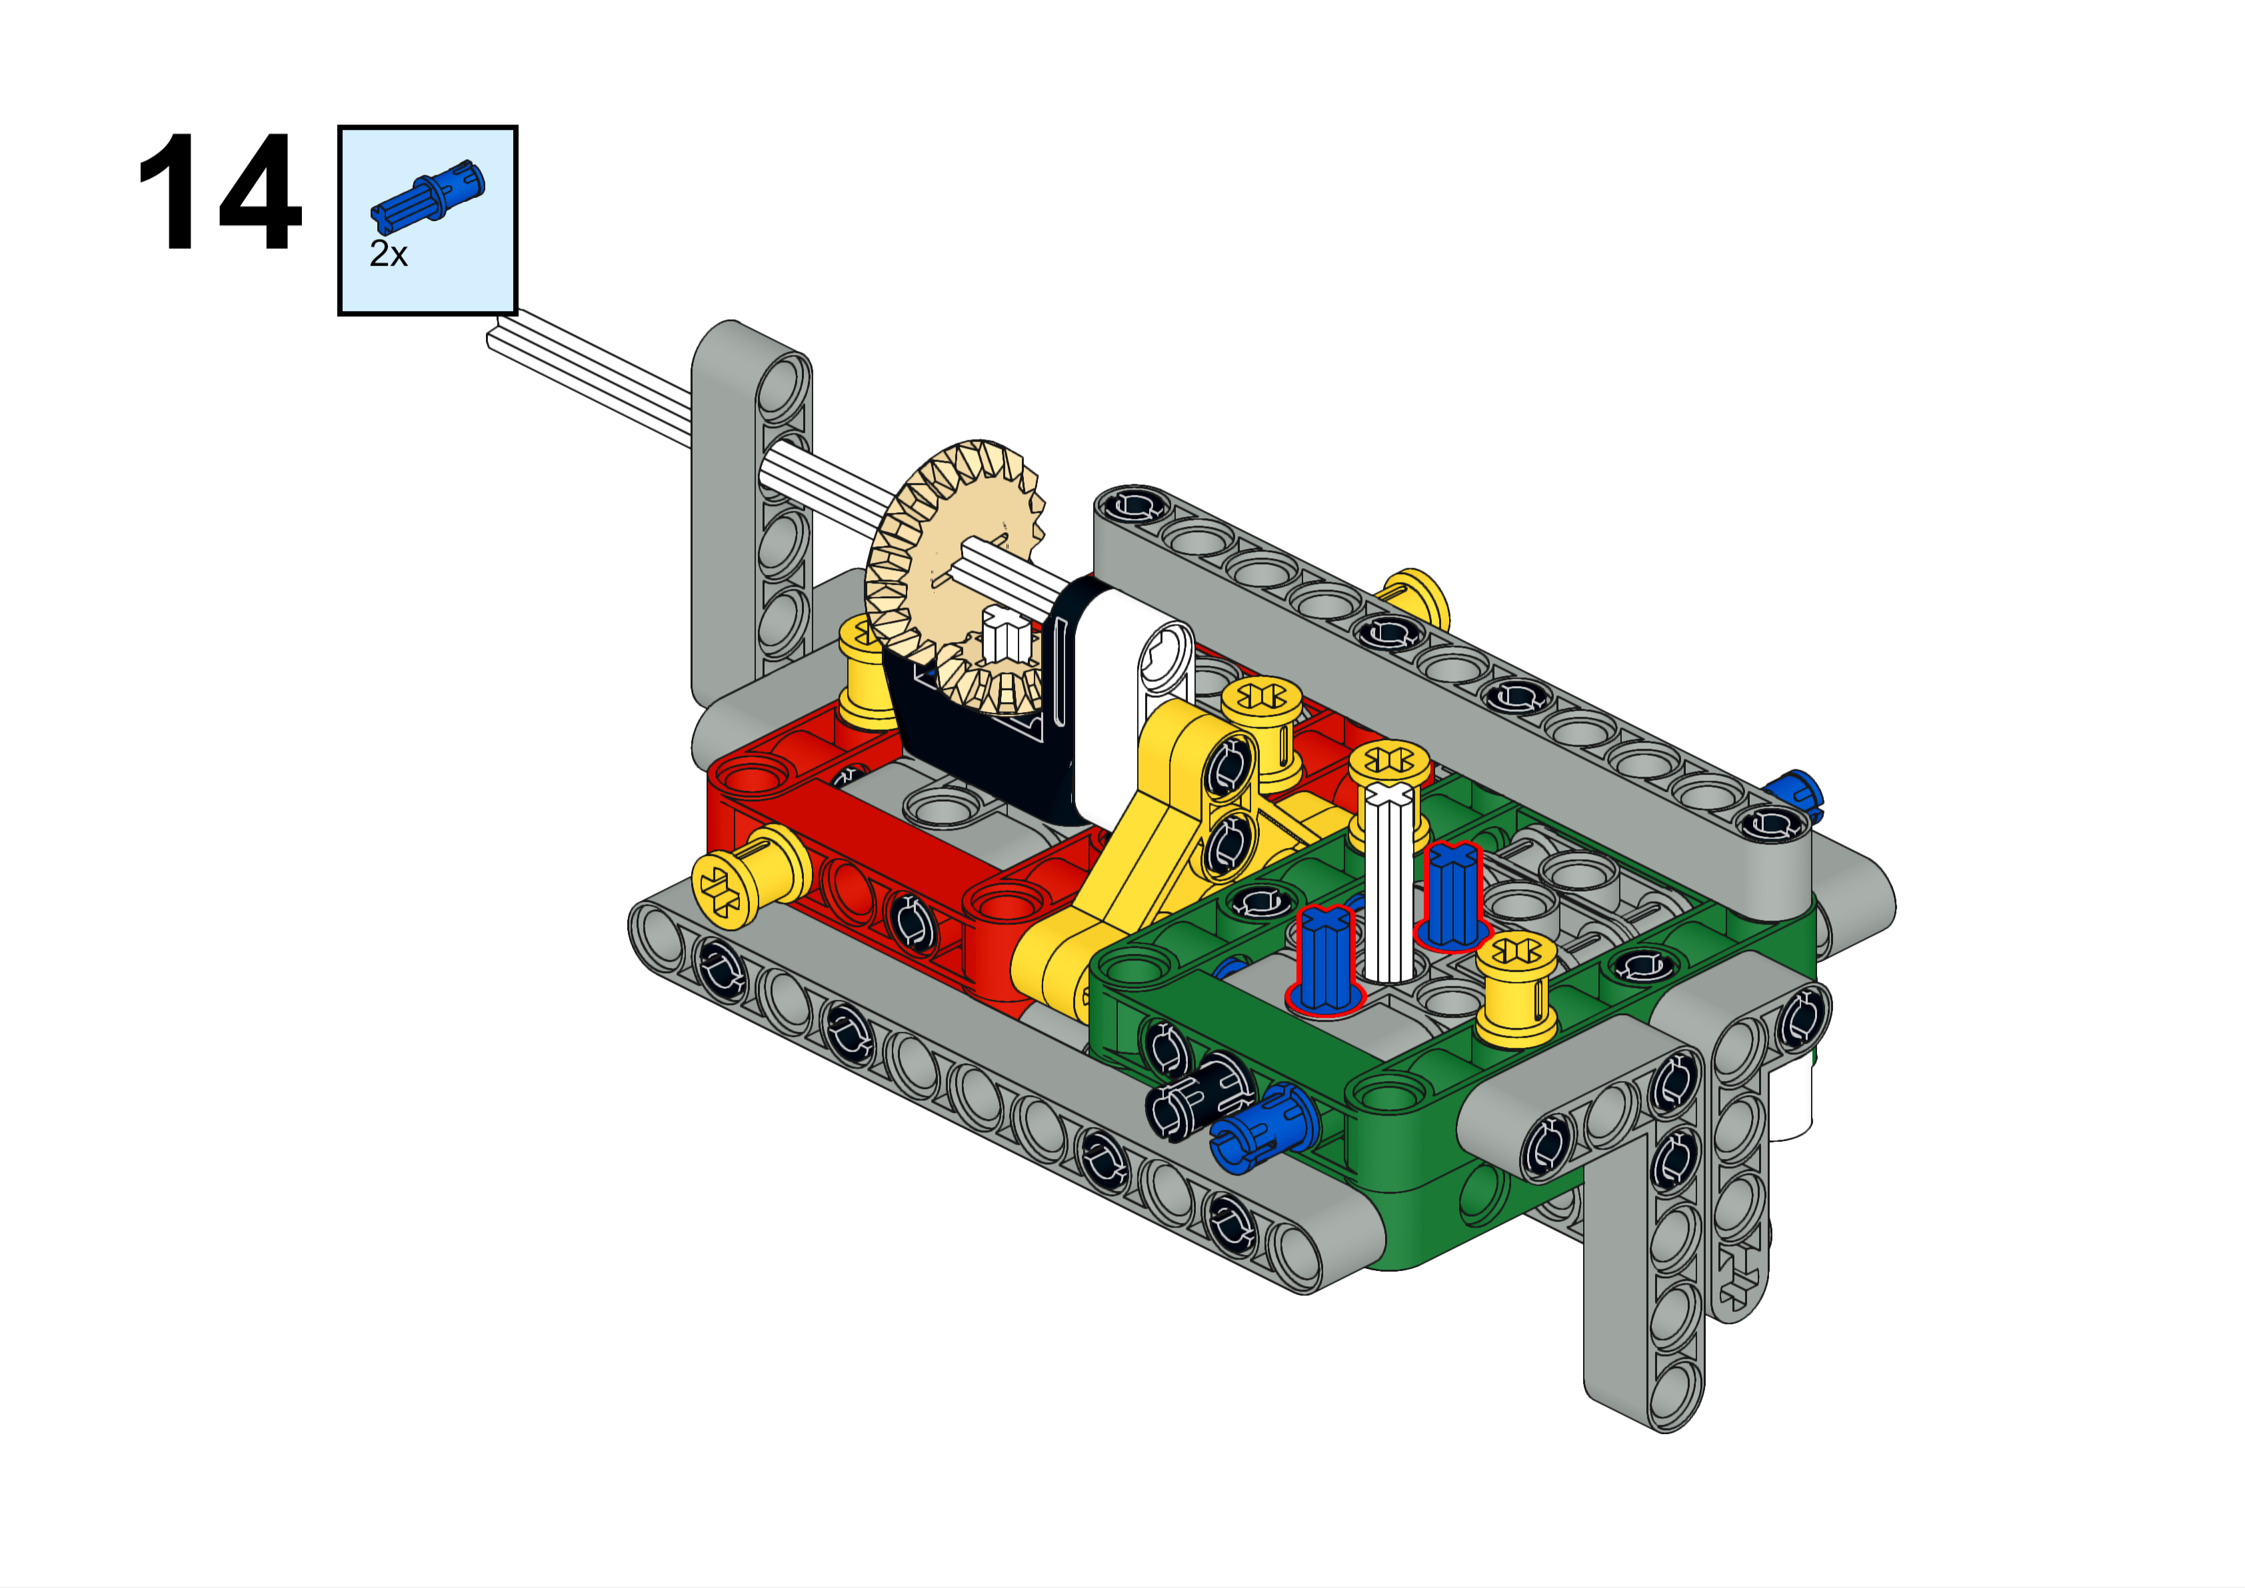

Slide 17
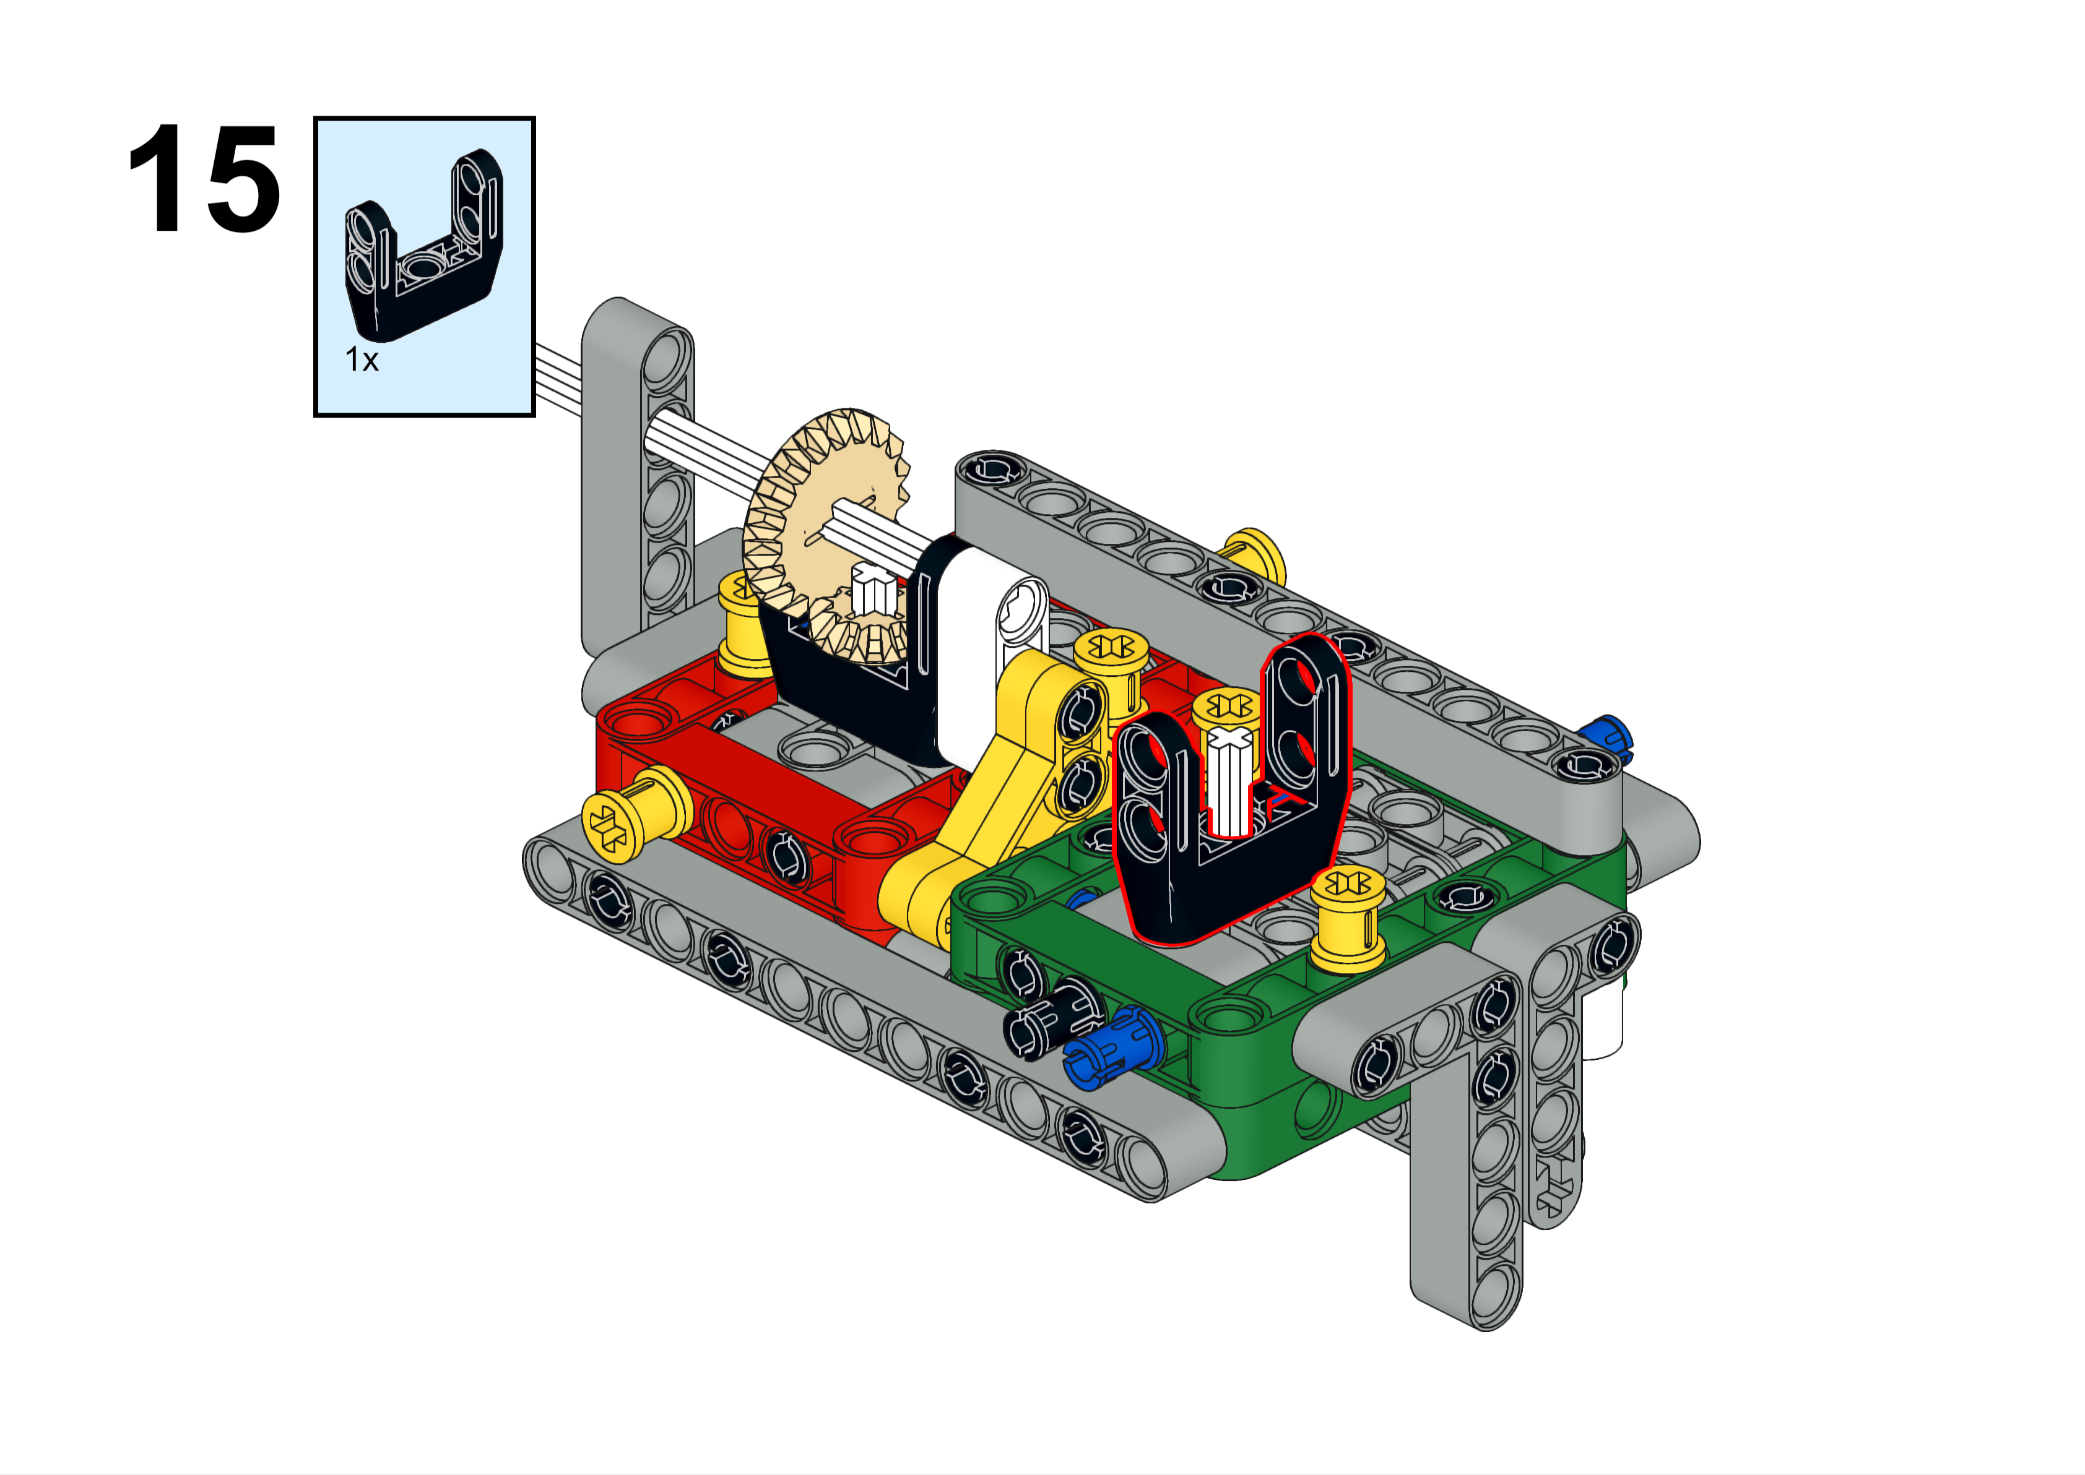

Slide 18
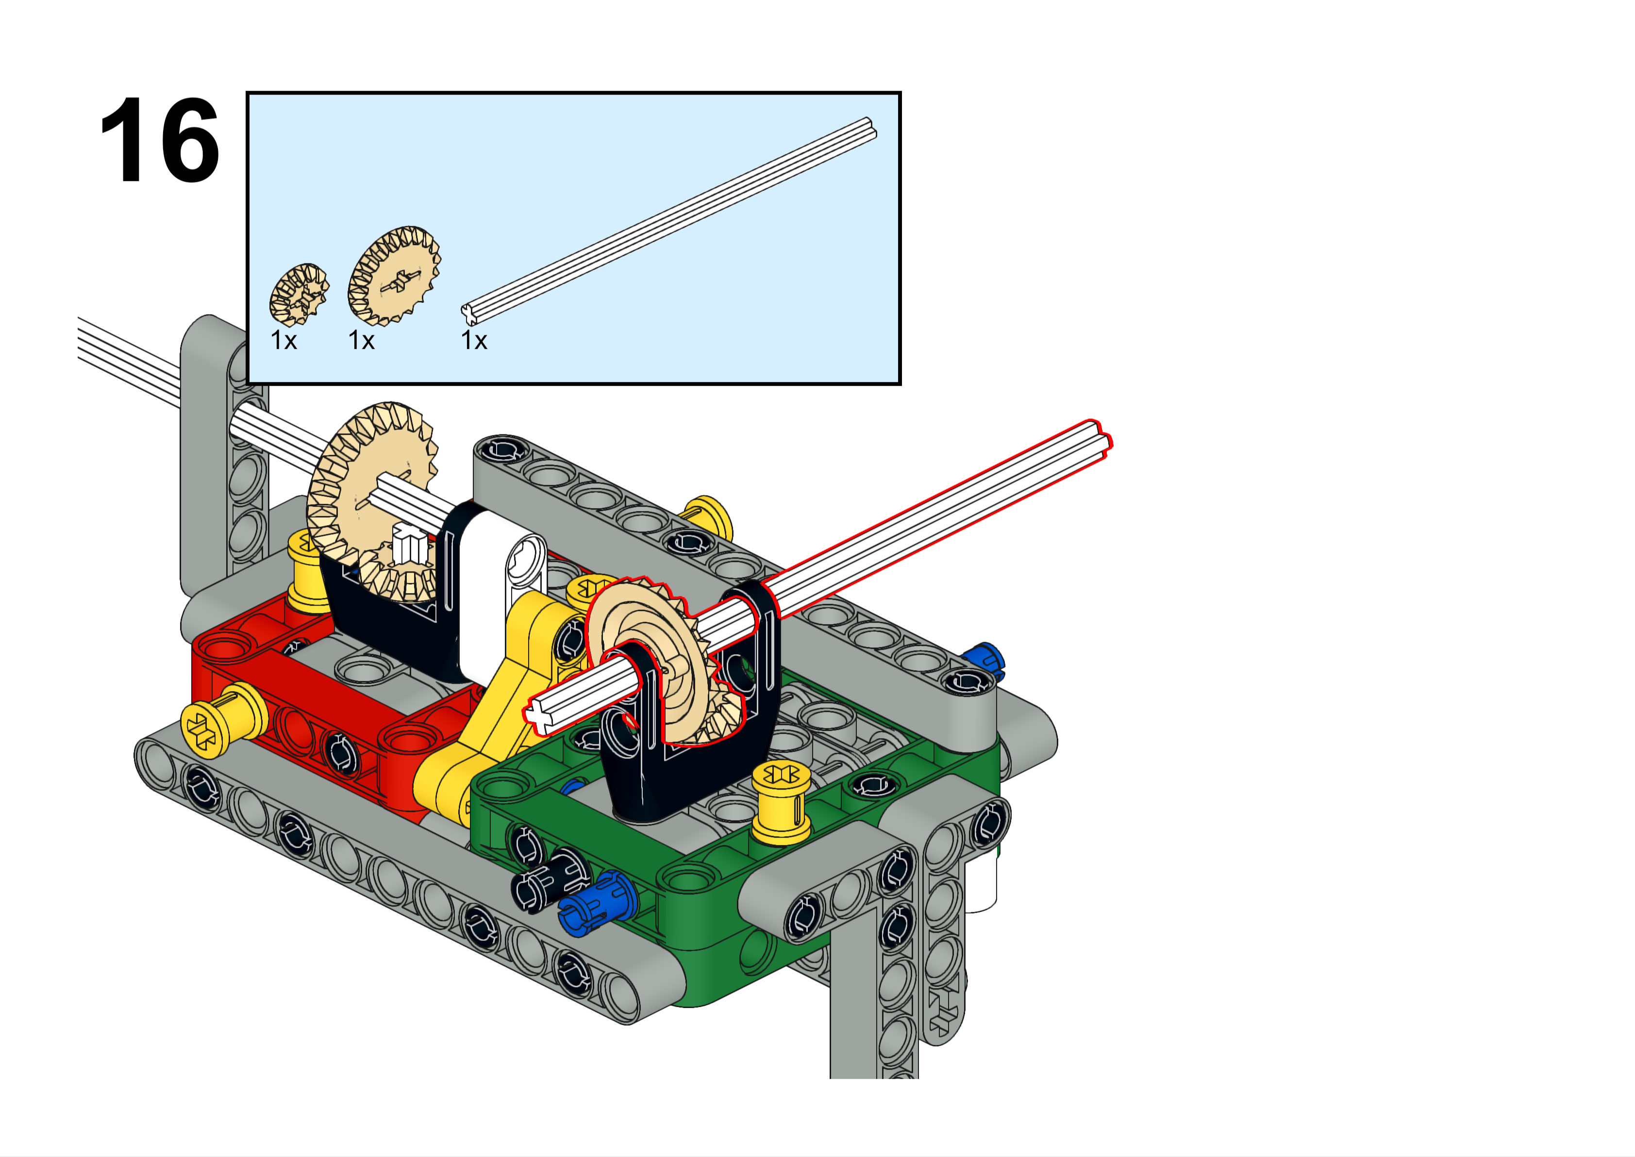
If you need 1:1 gearing, then do not use the large gear on this step. Instead, use this black gear below on the bottom and use the small tan gear on the back. See slide 2 for an example.

Slide 19
